Slide 1
Activation Functions

Slide 2
Outline
What is an Activation Function?
Why do we use an Activation Function?
Types of Activation Functions

Slide 3
What is an Activation Function?
The activation function of a node in an artificial neural network is a function that calculates the output of the node based on its individual inputs and their weights.

Slide 4
What is an Activation Function?
Activation functions apply a non-linear transformation and decide whether a neuron should be activated or not

Slide 5


$${Input: x}_{1}$$
$${ x}_{1}$$
Input Layer
Hidden Layer
Output Layer

Slide 6





$$Weights: w_{11},w_{12} ,w_{2},w_{3}$$
$$w_{11}$$
$$w_{2}$$
$${Input: x}_{1}$$
$${ x}_{1}$$
$$w_{12}$$
$$w_{3}$$
Input Layer
Hidden Layer
Output Layer

Slide 7







$$b$$
$$b_{11}$$
$$Weights: w_{11},w_{12} ,w_{2},w_{3}$$
$$Biases: b_{11},b_{12},b_{2}$$
$$w_{11}$$
$$w_{2}$$
$${Input: x}_{1}$$
$${ x}_{1}$$
$$w_{12}$$
$$w_{3}$$
$$b_{2}$$
$$b$$
$$b_{12}$$
$$b$$
Input Layer
Hidden Layer
Output Layer

Slide 8



$$b$$
$$b_{11}$$
$$z_{1}= w_{11} x_{1}+b_{11}$$
$$z_{1}$$
$$w_{11}$$
$$w_{2}$$
$${Input: x}_{1}$$
$${ x}_{1}$$
$$w_{12}$$
$$w_{3}$$
$$b_{2}$$
$$b$$
$$b_{12}$$
$$b$$

Slide 9



$$b$$
$$b_{11}$$
$$z_{1}= w_{11} x_{1}+b_{11}$$
$$z_{1}$$
$$w_{11}$$
$$w_{2}$$
$${Input: x}_{1}$$
$${ x}_{1}$$
$$w_{12}$$
$$w_{3}$$
$$z_{2}$$
$$b_{2}$$
$$b$$
$$b_{12}$$
$$b$$
$$z_{2}= w_{12} x_{1}+b_{12}$$

Slide 10







$$b$$
$$b_{11}$$
$$z_{1}= w_{11} x_{1}+b_{11}$$
$$z_{1}$$
$$h_{1}$$
$$h_{1}= σ(z_{1})$$
$$w_{11}$$
$$w_{2}$$
$${Input: x}_{1}$$
$${ x}_{1}$$
$$w_{12}$$
$$w_{3}$$
$$z_{2}$$
$$b_{2}$$
$$b$$
$$b_{12}$$
$$b$$
$$z_{2}= w_{12} x_{1}+b_{12}$$

Slide 11








$$b$$
$$b_{11}$$
$$z_{1}= w_{11} x_{1}+b_{11}$$
$$z_{1}$$
$$h_{1}$$
$$h_{1}= σ(z_{1})$$
$$w_{11}$$
$$w_{2}$$
$${Input: x}_{1}$$
$${ x}_{1}$$
$$w_{3}$$
$$w_{12}$$
$$z_{2}$$
$$h_{2}$$
$$b_{2}$$
$$b$$
$$b_{12}$$
$$b$$
$$h_{2}= σ(z_{2})$$
$$z_{2}= w_{12} x_{1}+b_{12}$$

Slide 12




$$b$$
$$b_{11}$$
$$z_{1}$$
$$h_{1}$$
$$z_{3}= h_{1} w_{2}+h_{2} w_{3}+b_{2}$$
$$w_{11}$$
$$w_{2}$$
$${Input: x}_{1}$$
$${ x}_{1}$$
$$z_{3}$$
$$w_{3}$$
$$w_{12}$$
$$z_{2}$$
$$h_{2}$$
$$b_{2}$$
$$b$$
$$b_{12}$$
$$b$$

Slide 13
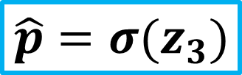




$$b$$
$$b_{11}$$
$$z_{1}$$
$$h_{1}$$
$$w_{11}$$
$$w_{2}$$
$${Input: x}_{1}$$
$${ x}_{1}$$
$$z_{3}$$
$$\hat{p}$$
$$w_{3}$$
$$\hat{p}=σ(z_{3})$$
$$w_{12}$$
$$z_{2}$$
$$h_{2}$$
$$b_{2}$$
$$b$$
$$b_{12}$$
$$b$$

Slide 14

Rectified Linear Unit (ReLU)
$$f\left(x\right)=max⁡(0,x)$$
Most popular choice for hidden layers
It takes the maximum of 0 and input x
If the input is negative, it outputs 0.
If the input is positive, it simply returns it without modification.

Slide 15

When to use ReLU?
$$f\left(x\right)=max⁡(0,x)$$
The rule of thumb is if you are not sure which activation function to use in your hidden layers then just use ReLU.

Slide 16
$$b$$
$$b_{11}$$
$$Weights: w_{11},w_{12} ,w_{2},w_{3}$$
$$Biases: b_{11},b_{12},b_{2}$$
$$w_{11}$$
$$w_{2}$$
$${Input: x}_{1}$$
$${ x}_{1}$$
$$w_{12}$$
$$w_{3}$$
$$b_{2}$$
$$b$$
$$b_{12}$$
$$b$$
Input Layer
Hidden Layer
Output Layer

Slide 17






$$b$$
$$???$$
$$Weights: w_{11},w_{12} ,w_{2},w_{3}$$
$$Biases: b_{11},b_{12},b_{2}$$
$$???$$
$$???$$
$${Input: x}_{1}$$
$${ x}_{1}$$
$$w_{12}$$
$$???$$
$$???$$
$$b$$
$$???$$
$$b$$
Input Layer
Hidden Layer
Output Layer

Slide 18







$$b$$
$$−0.85$$
$$1.70$$
$$−40.8$$
$${Input: x}_{1}$$
$${ x}_{1}$$
$$12.6$$
$$2.70$$
$$−16$$
$$b$$
$$0.00$$
$$b$$
Input Layer
Hidden Layer
Output Layer

Slide 19

$$b$$
$$−0.85$$
$$1.70$$
$$−40.8$$
$$0$$
$$12.6$$
$$2.70$$
$$−16$$
$$b$$
$$0.00$$
$$b$$
Input Layer
Hidden Layer
Output Layer

Slide 20

$$b$$
$$−0.85$$
$$z_{1}= w_{11} x_{1}+b_{11}$$
$$z_{1}$$
$$1.70$$
$$−40.8$$
$$0$$
$$12.6$$
$$2.70$$
$$−16$$
$$b$$
$$0.00$$
$$b$$
Input Layer
Hidden Layer
Output Layer

Slide 21

$$b$$
$$−0.85$$
$$z_{1}=1.70 ×0+(−0.85)$$
$$z_{1}$$
$$1.70$$
$$−40.8$$
$$0$$
$$12.6$$
$$2.70$$
$$−16$$
$$b$$
$$0.00$$
$$b$$
Input Layer
Hidden Layer
Output Layer

Slide 22

$$b$$
$$−0.85$$
$$z_{1}=−0.85$$
$$z_{1}$$
$$1.70$$
$$−40.8$$
$$0$$
$$12.6$$
$$2.70$$
$$−16$$
$$b$$
$$0.00$$
$$b$$
Input Layer
Hidden Layer
Output Layer

Slide 23






$$b$$
$$−0.85$$
$$z_{1}=−0.85$$
$$z_{1}$$
$$h_{1}$$
$$h_{1}=max(0,z_{1})$$
$$1.70$$
$$−40.8$$
$$h_{1}=max(0,−0.85)$$
$${Input: x}_{1}$$
$${ x}_{1}$$
$$2.70$$
$$12.6$$
$$−16$$
$$b$$
$$0.00$$
$$b$$

Slide 24






$$b$$
$$−0.85$$
$$h_{1}=max(0,z_{1})$$
$$z_{1}$$
$$h_{1}$$
$$h_{1}=max(0,−0.85)$$
$$1.70$$
$$−40.8$$
$$h_{1}=0$$
$${Input: x}_{1}$$
$${ x}_{1}$$
$$2.70$$
$$12.6$$
$$z_{2}$$
$$−16$$
$$b$$
$$0.00$$
$$b$$

Slide 25



$$b$$
$$−0.85$$
$$z_{1}$$
$$h_{1}$$
$$h_{1}=0$$
$$1.70$$
$$−40.8$$
$${Input: x}_{1}$$
$${ x}_{1}$$
$$2.70$$
$$12.6$$
$$z_{2}$$
$$−16$$
$$b$$
$$0.00$$
$$b$$
$$z_{2}= w_{12} x_{1}+b_{12}$$

Slide 26



$$b$$
$$−0.85$$
$$z_{1}$$
$$h_{1}$$
$$h_{1}=0$$
$$1.70$$
$$−40.8$$
$${Input: x}_{1}$$
$${ x}_{1}$$
$$2.70$$
$$12.6$$
$$z_{2}$$
$$−16$$
$$b$$
$$0.00$$
$$b$$
$$z_{2}=12.6 ×0+0$$

Slide 27



$$b$$
$$−0.85$$
$$z_{1}$$
$$h_{1}$$
$$h_{1}=0$$
$$1.70$$
$$−40.8$$
$${Input: x}_{1}$$
$${ x}_{1}$$
$$2.70$$
$$12.6$$
$$z_{2}$$
$$−16$$
$$b$$
$$0.00$$
$$b$$
$$z_{2}=0$$

Slide 28




$$b$$
$$−0.85$$
$$z_{1}$$
$$h_{1}$$
$$h_{1}=0$$
$$1.70$$
$$−40.8$$
$${Input: x}_{1}$$
$${ x}_{1}$$
$$2.70$$
$$12.6$$
$$z_{2}$$
$$h_{2}$$
$$−16$$
$$b$$
$$b$$
$$z_{2}=0$$
$$h_{2}=max(0,z_{2})$$

Slide 29




$$b$$
$$−0.85$$
$$z_{1}$$
$$h_{1}$$
$$h_{1}=0$$
$$1.70$$
$$−40.8$$
$${Input: x}_{1}$$
$${ x}_{1}$$
$$2.70$$
$$12.6$$
$$z_{2}$$
$$h_{2}$$
$$−16$$
$$b$$
$$b$$
$$h_{2}=max(0,0)$$
$$h_{2}=0$$

Slide 30



$$b$$
$$−0.85$$
$$z_{1}$$
$$h_{1}$$
$$h_{1}=0$$
$$1.70$$
$$−40.8$$
$${Input: x}_{1}$$
$${ x}_{1}$$
$$2.70$$
$$12.6$$
$$z_{2}$$
$$h_{2}$$
$$−16$$
$$b$$
$$b$$
$$h_{2}=0$$

Slide 31


$$b$$
$$−0.85$$
$$h_{1}=0$$
$$z_{1}$$
$$h_{1}$$
$$1.70$$
$$−40.8$$
$${Input: x}_{1}$$
$${ x}_{1}$$
$$z_{3}$$
$$2.70$$
$$12.6$$
$$z_{2}$$
$$h_{2}$$
$$−16$$
$$b$$
$$b$$
$$h_{2}=0$$

Slide 32
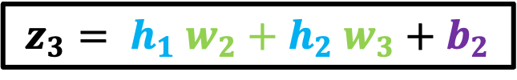
$$b$$
$$−0.85$$
$$h_{1}=0$$
$$z_{1}$$
$$h_{1}$$
$$1.70$$
$$−40.8$$
$${Input: x}_{1}$$
$${ x}_{1}$$
$$z_{3}$$
$$2.70$$
$$12.6$$
$$z_{2}$$
$$h_{2}$$
$$−16$$
$$b$$
$$b$$
$$h_{2}=0$$
$$z_{3}= h_{1} w_{2}+h_{2} w_{3}+b_{2}$$

Slide 33

$$b$$
$$−0.85$$
$$h_{1}=0$$
$$z_{1}$$
$$h_{1}$$
$$1.70$$
$$−40.8$$
$${Input: x}_{1}$$
$${ x}_{1}$$
$$z_{3}$$
$$2.70$$
$$12.6$$
$$z_{2}$$
$$h_{2}$$
$$−16$$
$$b$$
$$b$$
$$h_{2}=0$$
$$z_{3}=0 ×−40.8+0×2.70+(−16)$$

Slide 34

$$b$$
$$−0.85$$
$$z_{1}$$
$$h_{1}$$
$$1.70$$
$$−40.8$$
$${Input: x}_{1}$$
$${ x}_{1}$$
$$z_{3}$$
$$2.70$$
$$12.6$$
$$z_{2}$$
$$h_{2}$$
$$−16$$
$$b$$
$$b$$
$$z_{3}=−16$$

Slide 35
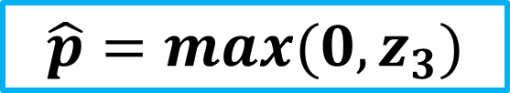
$$b$$
$$−0.85$$
$$z_{1}$$
$$h_{1}$$
$$1.70$$
$$\hat{p}=max(0,z_{3})$$
$$−40.8$$
$${Input: x}_{1}$$
$${ x}_{1}$$
$$z_{3}$$
$$\hat{p}$$
$$2.70$$
$$12.6$$
$$z_{2}$$
$$h_{2}$$
$$−16$$
$$b$$
$$b$$
$$z_{3}=−16$$

Slide 36
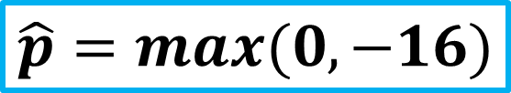
$$b$$
$$−0.85$$
$$z_{1}$$
$$h_{1}$$
$$1.70$$
$$\hat{p}=max(0,−16)$$
$$−40.8$$
$${Input: x}_{1}$$
$${ x}_{1}$$
$$z_{3}$$
$$\hat{p}$$
$$2.70$$
$$12.6$$
$$z_{2}$$
$$h_{2}$$
$$−16$$
$$b$$
$$b$$
$$z_{3}=−16$$

Slide 37
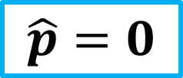
$$b$$
$$−0.85$$
$$z_{1}$$
$$h_{1}$$
$$1.70$$
$$\hat{p}=0$$
$$−40.8$$
$${Input: x}_{1}$$
$${ x}_{1}$$
$$z_{3}$$
$$\hat{p}$$
$$2.70$$
$$12.6$$
$$z_{2}$$
$$h_{2}$$
$$−16$$
$$b$$
$$b$$

Slide 38
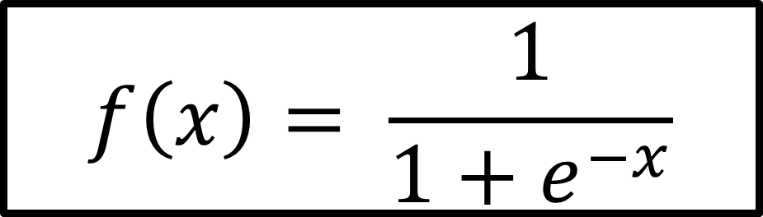
Sigmoid
$$f\left(x\right)= \frac{1}{1+e^{−x}}$$
Outputs a probability between 0 and 1
If the input is a very negative number, sigmoid outputs a number close to 0
If the input is a very positive number, sigmoid transforms it to a number close to 1
The more the positive the input number is, the more our neuron will be activated.

Slide 39
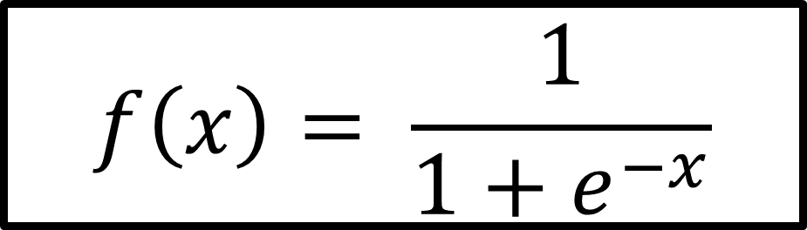
When to use Sigmoid?
$$f\left(x\right)= \frac{1}{1+e^{−x}}$$
Sometimes used in hidden layers.
Most of the time, it is used in the last layer for binary classification problems.

Slide 40
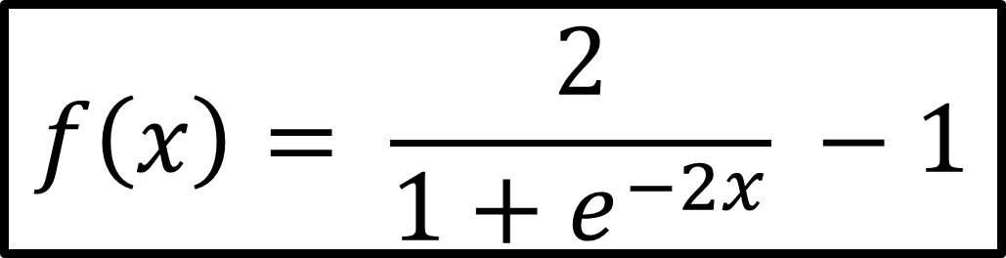
TanH (Hyperbolic Tangent)
$$f\left(x\right)= \frac{2}{1+e^{−2x}} −1$$
Basically a scaled and shifted sigmoid function
Outputs a number between -1 and +1

Slide 41
When to use TanH?
$$f\left(x\right)= \frac{2}{1+e^{−2x}} −1$$
Sometimes used in hidden layers.
Most of the time, it is used in the last layer for binary classification problems.

Slide 42
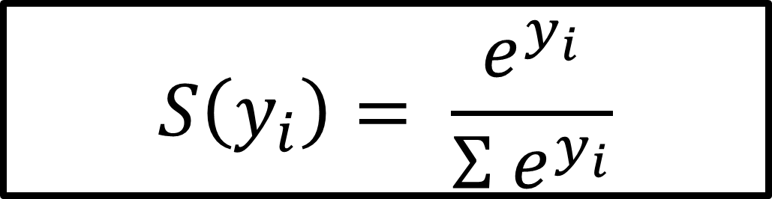
Softmax
$$S\left(y_{i}\right)= \frac{e^{y_{i}}}{{Σ e}^{y_{i}}}$$
Transforms the input to output a probability number between 0 and 1
The higher the input number, the higher will be the probability value

Slide 43
When to use Softmax?
$$S\left(y_{i}\right)= \frac{e^{y_{i}}}{{Σ e}^{y_{i}}}$$
It is usually used in the last layer in multi-class classification problems
Softmax decides for the class with the highest probability

Slide 44
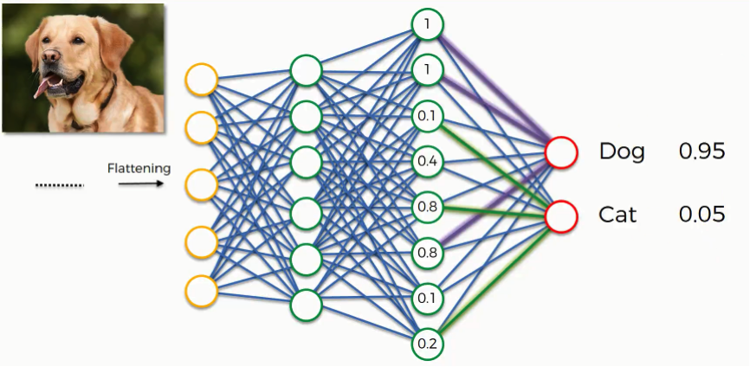
When to use Softmax?

